Slide 1
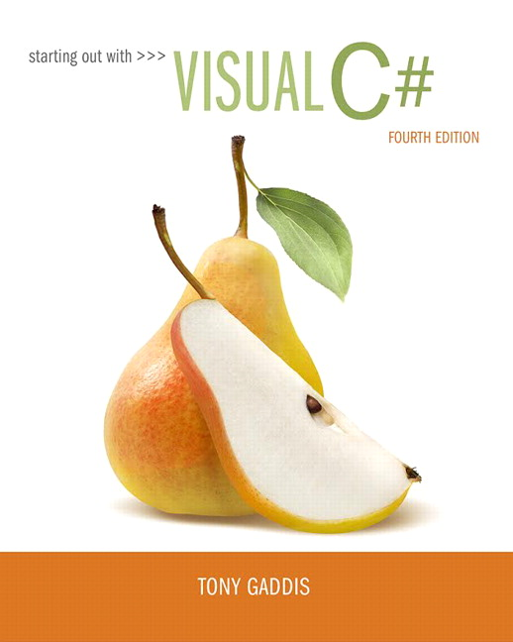
Starting out with Visual
Fourth Edition
Chapter 4
Making Decisions
Copyright © 2017, 2014, 2012 Pearson Education, Inc. All Rights Reserved
Notes:
If this PowerPoint presentation contains mathematical equations, you may need to check that your computer has the following installed:
1) MathType Plugin
2) Math Player (free versions available)
3) NVDA Reader (free versions available)

Slide 2
Topics (1 of 2)
4.1 Decision Structures and the if Statement
4.2 The if-else Statement
4.3 Nested Decision Structures
4.4 Logical Operators
4.5 bool Variables and Flags
4.6 Comparing Strings

Slide 3
Topics (2 of 2)
4.7 Preventing Data Conversion Exceptions with the TryParse Method
4.8 Input Validation
4.9 Radio Buttons and CheckBoxes
4.10 The switch Statement
4.11 Introduction to List Boxes

Slide 4
4.1 Decision Structures
A control structure is a logical design that controls the order in which statements execute
A sequence structure is a set of statements that execute in the order that they appear
A decision structure execute statements only under certain circumstances
A specific action is performed only if a certain condition exists
Also known as a selection structure

Slide 5
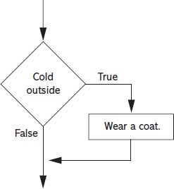
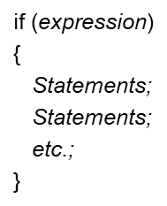
A Simple Decision Structure
The flowchart is a single-alternative decision structure
It provides only one alternative path of execution
In
you can use the if statement to write such structures. A generic format is:
The expression is a Boolean expression that can be evaluated as either true or false

Slide 6
Relational Operators
A relational operator determines whether a specific relationship exists between two values
Operator | Meaning | Expression | Meaning
> | Greater than | x > y | Is x greater than y?
< | Less than | x < y | Is x less than y?
>= | Greater than or equal to | x >= y | Is x greater than or equal to y?
<= | Less than or equal to | x <= y | Is x less than or equal to you?
== | Equal to | x == y | Is x equal to y?
!= | Not equal to | x != y | Is x not equal to you?

Slide 7
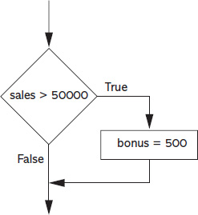

if Statement with Boolean Expression

Slide 8
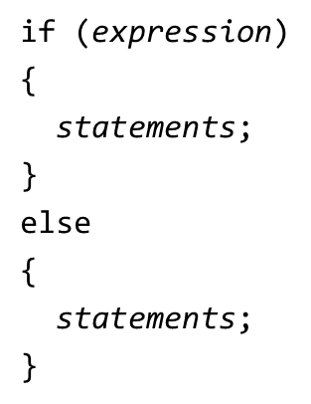
4.2 The if-else Statement
An if-else statement will execute one block of statement if its Boolean expression is true or another block if its Boolean expression is false
It has two parts: an if clause and an else clause
In
a generic format looks:

Slide 9
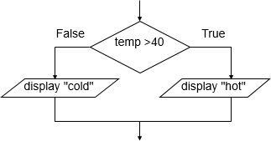
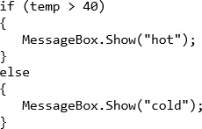
Example of if-else Statement

Slide 10
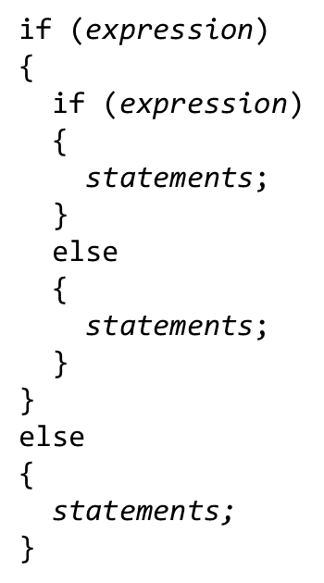
4.3 Nested Decision Structures
You can create nested decision structures to test more than one condition.
Nested means “one inside another”
In
a generic format is:

Slide 11
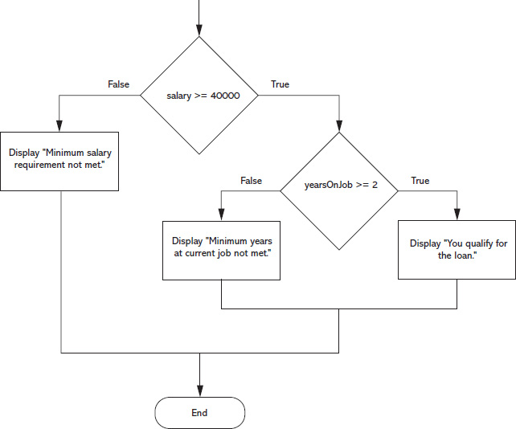
A Sample Nested Decision Structure (1 of 2)

Slide 12
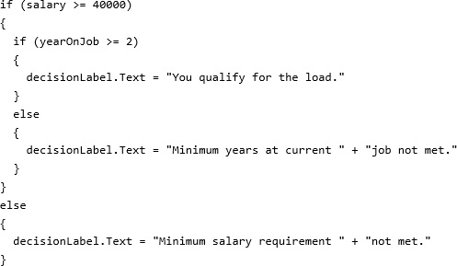
A Sample Nested Decision Structure (2 of 2)

Slide 13
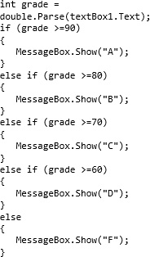
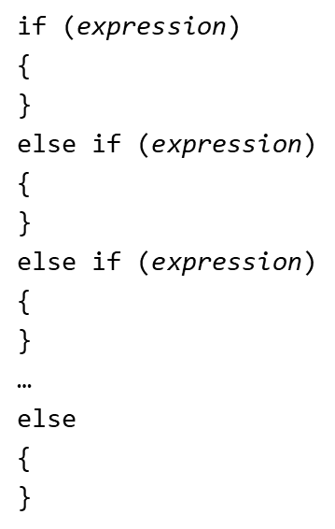
The if-else-if Statement
You can also create a decision structure that evaluates multiple conditions to make the final decision using the if-else-if statement
In
the generic format is:

Slide 14
4.4 Logical Operators
The logical AND operator (&&) and the logical OR operator (||) allow you to connect multiple Boolean expressions to create a compound expression
The logical NOT operator (!) reverses the truth of a Boolean expression
Operator | Meaning | Description
&& | AND | Both subexpression must be true for the compound expression to be true
|| | OR | One or both subexpression must be true for the compound expression to be true
! | NOT | It negates (reverses) the value to its opposite one.
Expression | Meaning
x >y && a < b | Is x greater than y AND is a less than b?
x == y || x == z | Is x equal to y OR is x equal to z?
! (x > y) | Is the expression x > y NOT true?

Slide 15



Sample Decision Structures with Logical Operators
The && operator
The || operator
The ! Operator

Slide 16
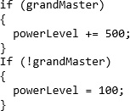
4.5 bool Variables and Flags
You can store the values true or false in bool variables, which are commonly used as flags
A flag is a variable that signals when some condition exists in the program
False – indicates the condition does not exist
True – indicates the condition exists

Slide 17


4.6 Comparing Strings
You can use certain relational operators and methods to compare strings. For example,
The == operator can compare two strings
You can compare string variables with string literals, too
The String.Compare method can compare two strings

Slide 18
4.7 Preventing Data Conversion Exception
Exception should be prevented when possible
The TryParse methods can prevent exceptions caused by users entering invalid data
int.TryParse
doubel.TryParse
decimal.TryParse
The generic syntax is:
The out keyword is required; it specifies that the targetVariable is an output variable

Slide 19
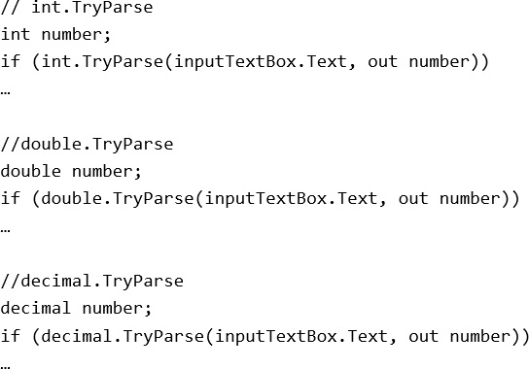
Samples of TryParse Methods

Slide 20
4.8 Input Validation
Input validation is the process of inspecting data that has been entered into a program to make sure it is valid before it is used
TryParse methods check if the user enters the data, but it does not check the integrity of the data. For example,
In a payroll program we might validate the number of hours worked.
In a program that gets test scores, we can limits its data to an integer range of 0 through 100.

Slide 21
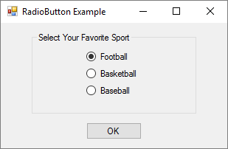
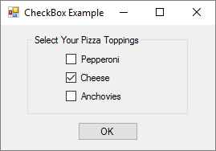
4.9 Radio Buttons and Check Boxes
Radio buttons allow users to select one choice from several possible choices
Clicking on a radio button, the program automatically deselects any others. This is known as mutually exclusive selection
Check boxes allows users to select multiple options

Slide 22
Radiobutton Control
The .N E T Framework provides the RadioButton Control for you to create a group of radio buttons
Common properties are:
Text: holds the text that is displayed next to the radio button
Checked: a Boolean property that determines whether the control is selected or deselected

Slide 23
Working with Radio Buttons in Code
In code, use a decision structure to determine whether a RadioButton is selected. For example,
You do not need to use the == operator, although the following is equivalent to the above

Slide 24
Checkbox Control
The .NET Framework provide the CheckBox Control for you to give the user an option, such as true/false or yes/no
Common properties are:
Text: holds the text that is displayed next to the radio button
Checked: a Boolean property that determines whether the control is selected or deselected
In code, use a decision structure to determine whether a CheckBox is selected. For example,

Slide 25
The CheckedChanged Event
Anything a RadioButton or a CheckBox control's Checked property changes, a CheckedChanged event is raised
You can create a CheckedChanged event handler and write codes to respond to the event
Double click the control in the Designer to create an empty CheckedChanged event handler similar to:

Slide 26
4.10 The switch Statement
The switch statement lets the value of a variable or an expression determine which path of execution the program will take
It is a multiple-alternative decision structure
It can be used as an alternative to an if-else-if statement that tests the same variable or expression for several different values

Slide 27
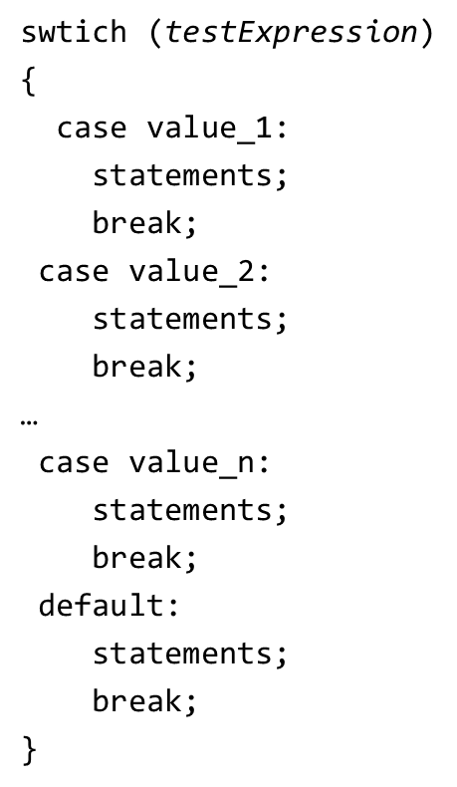
Generic Format of the switch Statement
The testExpression is a variable or an expression that given an integer, string, or bool value. Yet, it cannot be a floating-point or decimal value.
Each case is an individual subsection containing one or more statements, followed by a break statement
The default section is optional and is designed for a situation that the testExpression will not match with any of the case

Slide 28
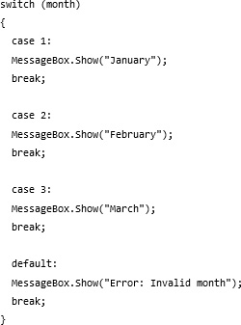
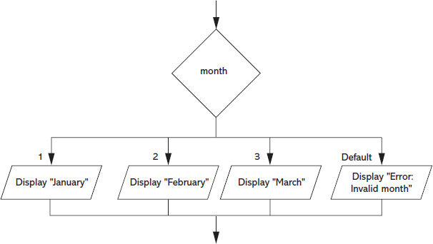
Sample switch Statement

Slide 29
4.11 Introduction to List Boxes
A list box displays a list of items and allow the user to select an item from the list
In
you can use the ListBox control to create a list box
Commonly used properties are:
Text: Gets or searches for the text of the currently selected item in the ListBox
Items: Gets the items of the ListBox
SelectedItem: Gets or sets the currently selected item in the ListBox. When the user selects an item, the item is stored in this property. You can use the following to get the selected item from a list box:
SelectedIndex: Gets or sets the zero-based index of the currently selected item in a ListBox

Slide 30
Selecteditem
An exception will occur if you try to get the value of a ListBox’s SelectedItem property when no item is selected
Items in a list box have an index starting with 0
The first item has index 0, the nth item has index n-1
The SelectedIndex property keeps the index. If no item is selected the, value of SelectedIndex is -1
The following is an example to use SelectedIndex property to make sure that an item is selected before you get the value from SelectedItem.

Slide 31
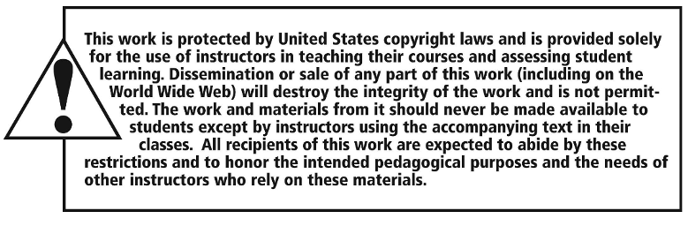
Copyright

